Slide 1
The design of a circuit board
Thomas Russell Murphy
20140212
From Conception to Assembly

Slide 2
Overview of Process
Development of Specifications
Schematic Capture
Layout and Component Definition
Prototype Manufacturing
Software Options
+Demonstrations of gEDA and Rev. 1 Product

Slide 3
Development of Specification
What do you want your board to do?
How will it communicate with any desired peripherals or output devices?
Choose core components and interfaces
Complete at least a block-level schematic of the layout between onboard devices and their interfaces

Slide 4
Schematic Capture
Interconnection of components
Need to have symbols to represent each component being used in the design
Fulfillment of specifications
Need to define initial power layout: supply, regulated rails, decoupling capacitors
End: All connections made, Bill of Materials completed

Slide 5
Layout: Footprints and Form Factors
Before the connections (netlist) from your schematic are useful, you have to know what the components your are using look like
Need to look forward: some parts may be difficult or impossible to hand prototype
Need accurate layouts: if something is critical and you didn’t pay for it with support, you need to verify an existing design or DIY
MIT Student: “To whoever uses the Sparkfun eagle library for a Nokia LCD footprint: the pins are reversed!”
http://fab.cba.mit.edu/classes/MIT/863.09/people/gershon/final_project.html

Slide 6
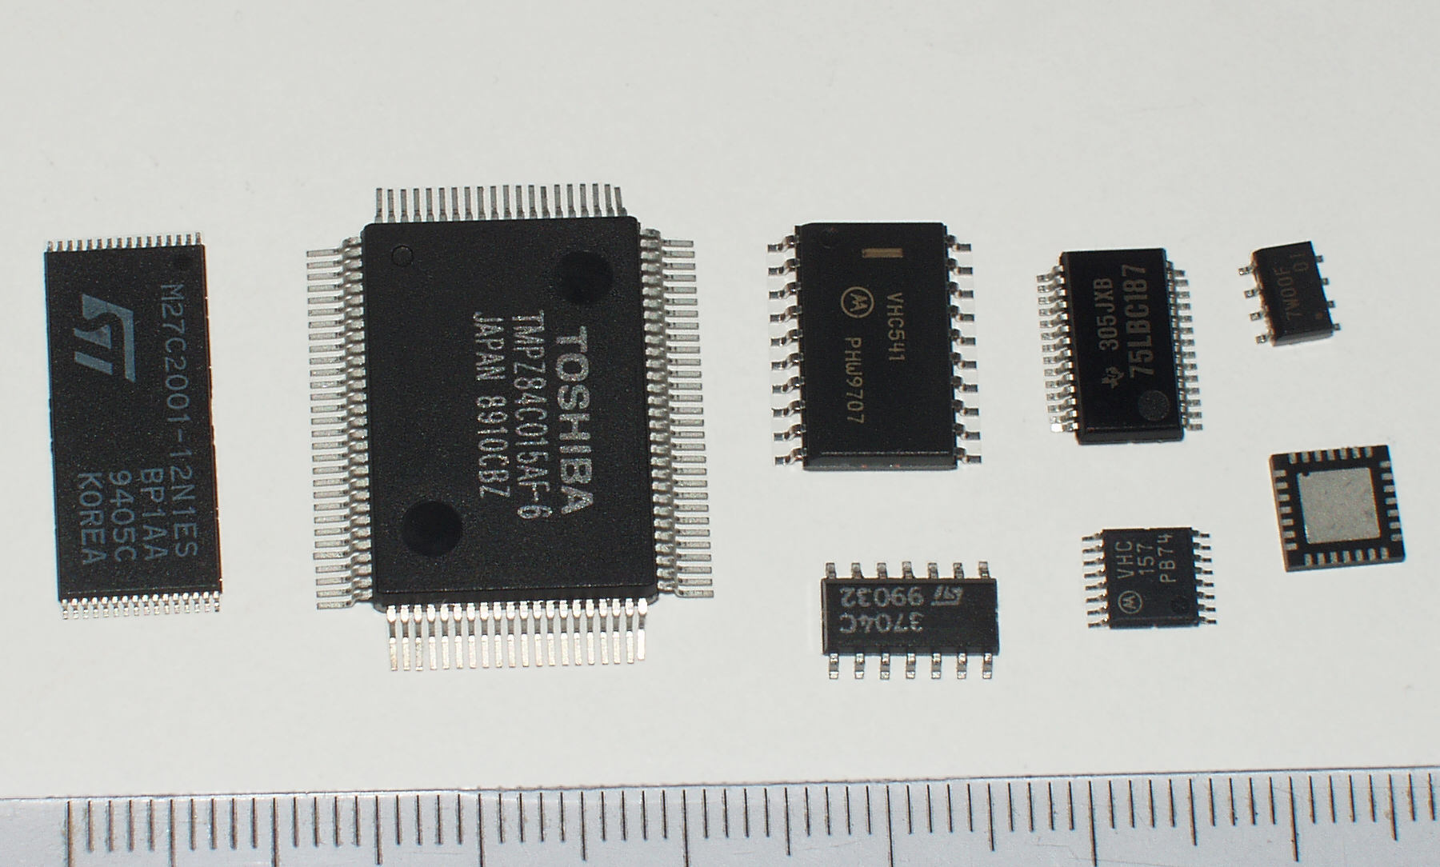
Integrated Circuits: TSSOP RQFP SO SSOP QFN
Surface mount devices are the present. While some components may be through-hole, the logic of the board will likely be SMDs. All of these can be used in hand-assembled prototypes, though QFN requires special work.
https://commons.wikimedia.org/wiki/File:TSSOP_RQFP_SO_SSOP_QFN.jpg

Slide 7
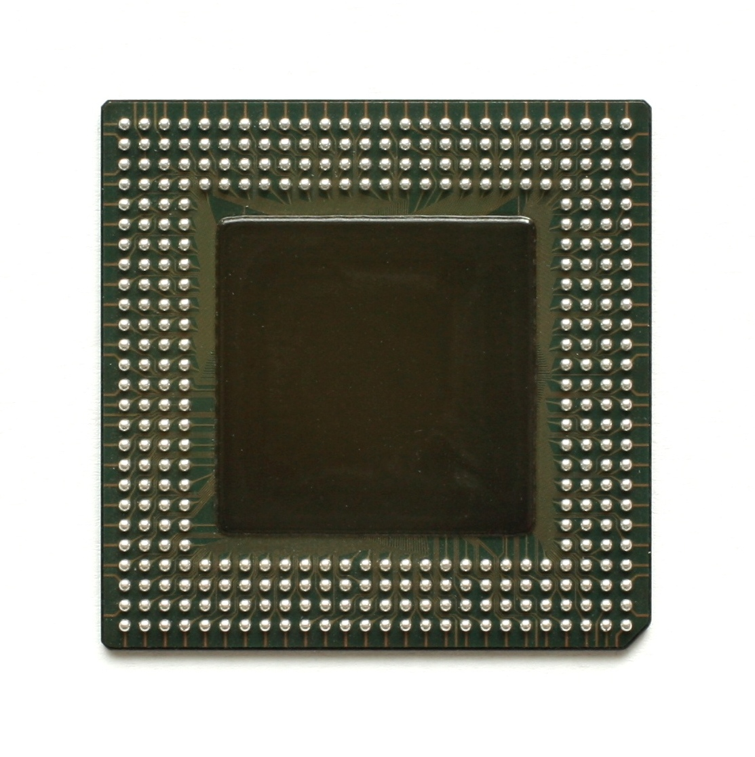
High Density Connections: Ball Grid Array
A soldering iron will no longer do. Assembling a board with a BGA part will require reflow in a temperature controlled oven. This part may also need to be machine-positioned to accurately place it on the board.
https://en.wikipedia.org/wiki/File:Kl_Intel_Pentium_MMX_embedded_BGA_Bottom.jpg

Slide 8
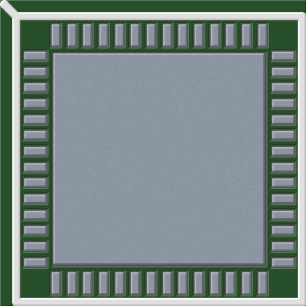
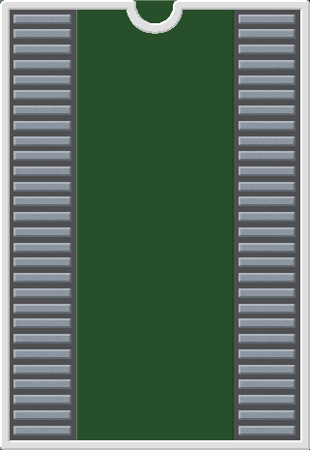
Some Standardized Footprints
QFN56_8_EP
TSSOP56N
These are probably safe to work with for JEDEC standard part footprints.

Slide 9
Layout: Designing the Connections
Implementing the connections between components
Optimizing graph of the netlist with wires
Greater density of connections requires more layers to efficiently complete the network
Need to consider trace lengths and configurations
Varying requirements for connections: low-resistance power, ground planes, integrity of high-frequency signals, matching

Slide 10
Layout: Complexity Options
Everything determined by manufacturer
Layers of board: 1, 2, 4, and higher
Substrate material, thickness: FR4, ceramic
Copper plating: 0.5, 1, 2, 3 oz/sq. ft
Manufacturing parameters: trace size, copper spacing, annular ring width, drill sizes, board cutting/routing

Slide 11
Manufacturing a Prototype
Cost is proportional to all of quality, speed, product complexity, and board features
Without in-house manufacturing, a PCB will easily take >2 weeks to arrive for assembly
Medium quality, fast, low complexity, bare minimum features: ThinkBox Router
Complete: medium-high quality, 2+ weeks, low to medium complexity, standard features: Osh Park, Advanced Circuits

Slide 12
Hand Assembly of Board
Through-hole only: solder with lab stump-tip irons
SMD ~1mm/50mil: solder with a fine-tipped iron
SMD smaller: solder with fine-tipped iron, viewing with a microscope
Large-pad chips or BGA: good luck reflowing with a hot plate and a hot air source

Slide 13
The Gist of Production
http://www.bunniestudios.com/blog/?p=2407
Need to order tape-on-reel parts (1-5k per reel)
1x1.5 meter raw copperclad FR-4
Massive drilling machines
Long series of automated chemical tanks
Boards from one place, assembly elsewhere
Overall, not a simple task

Slide 14
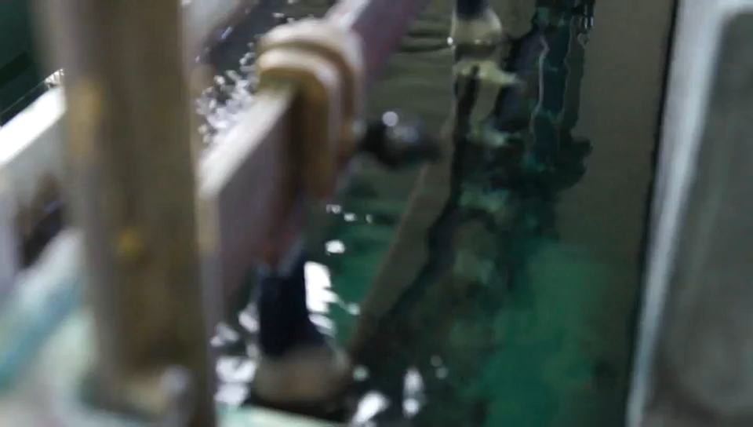
Production of Boards: Etching Phase
Some video from the blog post on the production of Arduino boards. This shows off the automation and scale required.

Slide 15
Additional Assembly Options
Better and faster than tweezer-placement
Apply solder paste and adhesive to board
Manual pick-and-place: load reel of components and control X,Y placement by hand
Automated pick-and-place: load reels of components, panelized boards, and part positioning information
Follow with small or large reflow oven to make connections

Slide 16
Software (Complete EDA)
No good news here
FOSS: gEDA (gschem, pcb, utilities), KiCAD
Crippled Freeware: EAGLE Light Edition
Enthusiastic hobbyist, Student Edition, something for support on a budget: ????
Production Enterprise ($$$): Altium Designer, EAGLE

Slide 17
A Brief Demonstration
gEDA: Building a really simple board

